Slide 1

"ECOVAULT: A SUSTAINABLE BLOCKCHAIN SOLUTION FOR SECURE DATA SHARING"
S
SCITECH AND SUSTAINABILITY FOR INDUSTRY 5.0

Slide 2

MEMBERS
01
Shivam Goyat (BTECH CSE CYBER SECURITY)
02
Kunal Kadyan (BTECH CSE CYBER SECURITY)
03
Tanushree Mohanty (BTECH CSE CYBER SECURITY)
04
Abhishek (BTECH CSE BLOCKCHAIN)

Slide 3

ADDRESSING RECORD MANAGEMENT CHALLENGES
Traditional legal record management systems lack transparency, security, and accessibility. Centralized databases are vulnerable to breaches and manipulation, posing risks to sensitive information.

Slide 4

PROJECT OBJECTIVES
Our project aims to develop a blockchain-based eVault system for highly confidential, ensuring security, transparency, and accessibility for all stakeholders. We seek to revolutionize legal record management and mitigate the risks associated with traditional systems.

Slide 5

METHODOLOGY OVERVIEW
Our solution leverages blockchain technology for decentralized and transparent record-keeping. Smart contracts enforce access controls and encryption techniques ensure data security. Users interact with the system through an intuitive web interface.
MISSION

Slide 6
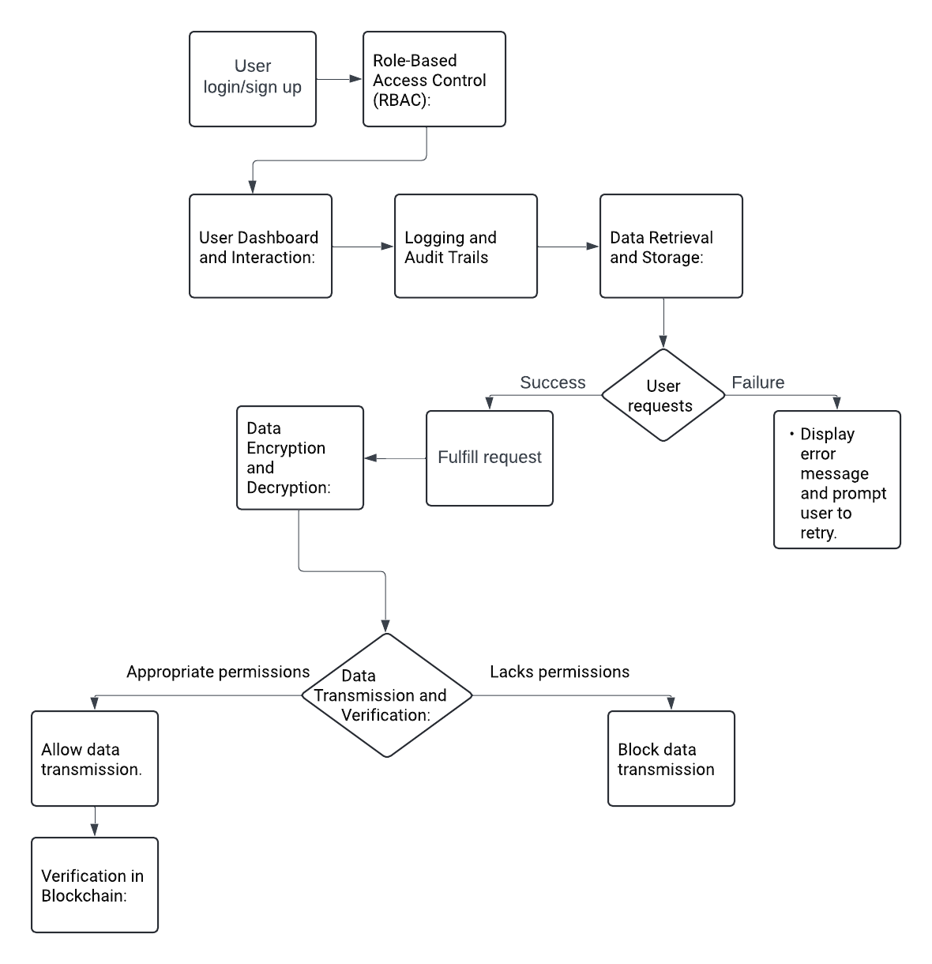
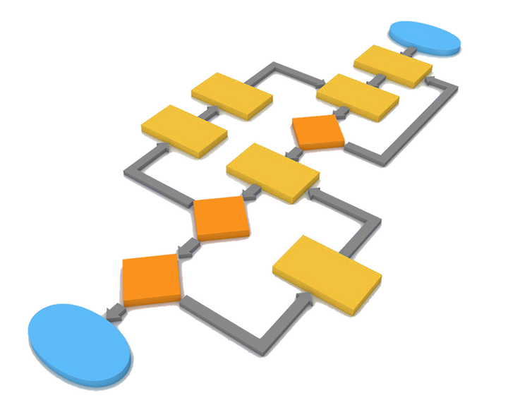
SYSTEM ARCHITECTURE

Slide 7


INNOVATIVE FEATURES
Our eVault system offers end-to-end encryption, role-based access control, and transparent audit trails. Unlike traditional systems, it eliminates single points of failure and ensures data integrity through blockchain technology.
Thynk Unlimited

Slide 8


Thynk Unlimited
SUSTAINABILITY IMPACT
By digitizing and securely managing highly confidential data, our project promotes environmental sustainability by reducing paper usage and minimizing carbon footprint. Blockchain's energy-efficient consensus mechanism further contributes to sustainability efforts.

Slide 9

Total Available Market (TAM)
FUTURE INNOVATION
We envision expanding our eVault system to various industries requiring secure management of highly confidential data, such as healthcare, finance, and government sectors. Integration with emerging technologies offers new opportunities for innovation and scalability.

Slide 10

EXPECTED OUTCOMES
Our deliverables include a robust blockchain-based eVault system capable of securely managing highly confidential data across industries. We anticipate improved data security, accessibility, and transparency for stakeholders in various sectors.

Slide 11
THANK YOU
FOR YOUR NICE ATTENTION

